Slide 1



Predicting Diabetes Diagnoses From Health Indicators
Team Cache Me Outside
Jenna Chan, Nidhi Shinde, Tammy Si
Notes:
tammy

Slide 2

Dataset Description
Sourced from UCI’s Machine Learning Repository
Data Collection
Funded by CDC
Purpose: To better understand the relationship between lifestyle and diabetes in the US
Characteristics:
253,680 instances
21 features
Health indicators, demographics, income level, education, etc.
Notes:
tammy

Slide 3
Preliminary Data Analysis
Target variable: Diabetes Diagnosis
0 = Healthy, 1 = Prediabetes, 2 = Diabetes
Explanatory variables:
Demographics
Lifestyle Factors
Health Conditions
Sex
Age
Education Level
Income
Smoker
AlcoholConsumption
Phys Activity Level
Fruits
Veggies
Healthcare
HighBP
HighChol
BMI
Stroke
MentalHealth
HeartDiseaseorAttack
Notes:
tammy

Slide 4
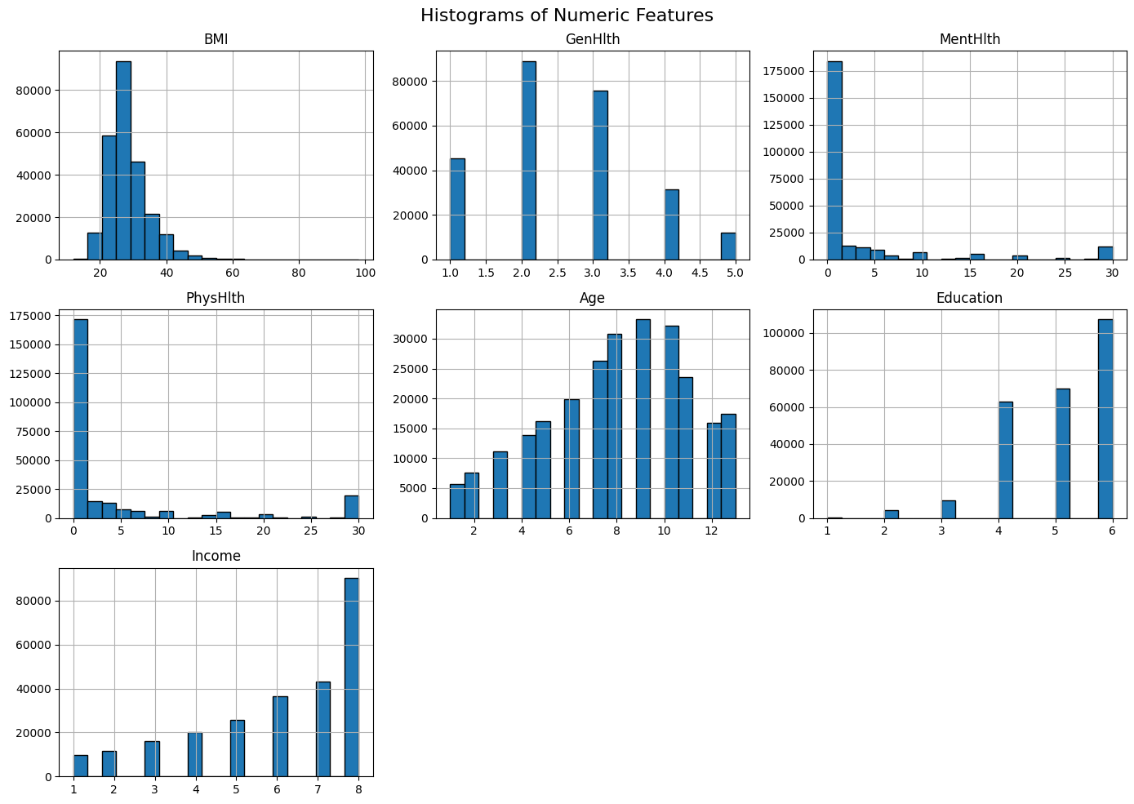
Preliminary Data Analysis
Mean BMI of ~28 (overweight)
Most patients at level 4 (high school graduate) or beyond
Income distribution skewed left → more wealth ($75k / yr +)
Most patients have <5 days / month with bad mental health
Most patients have < 5 days / month with bad physical health
Notes:
Tammy

Slide 5
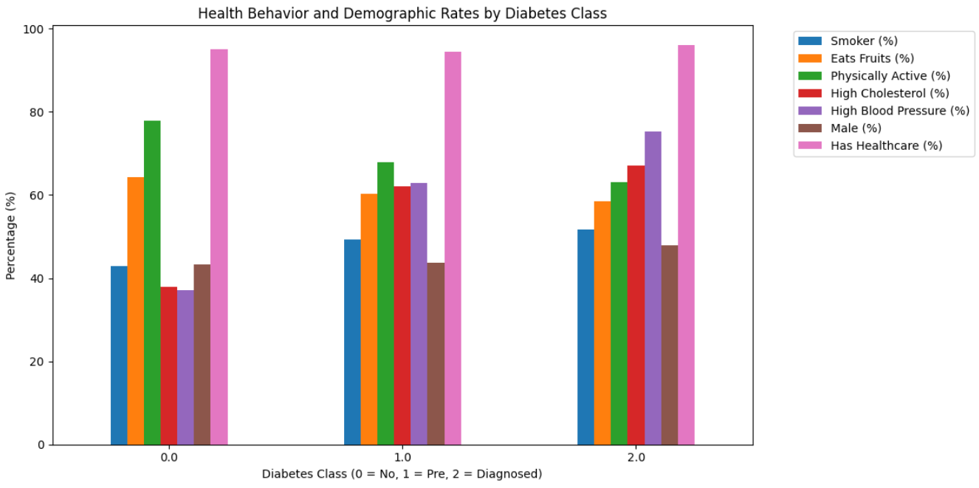
Preliminary Data Analysis
Notes:
Jenna

Slide 6
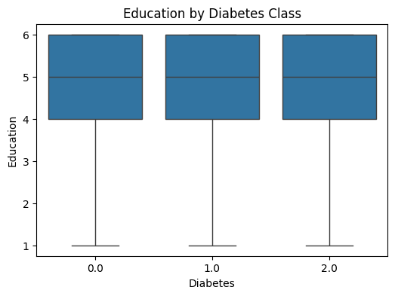
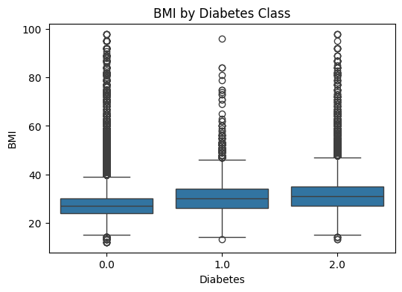
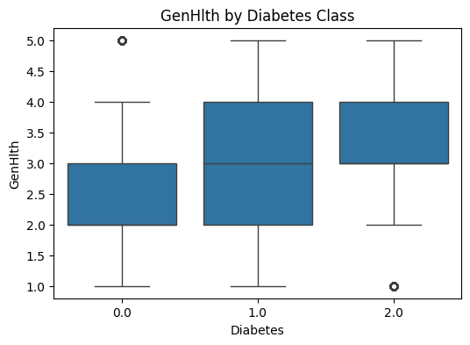
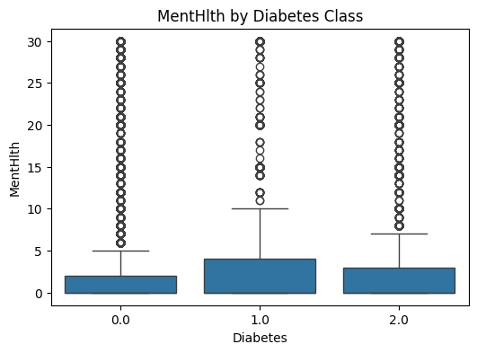
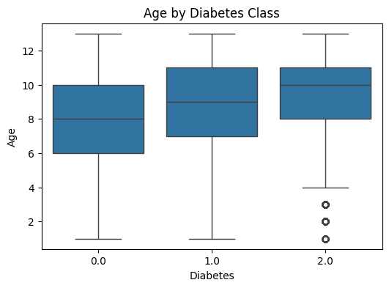
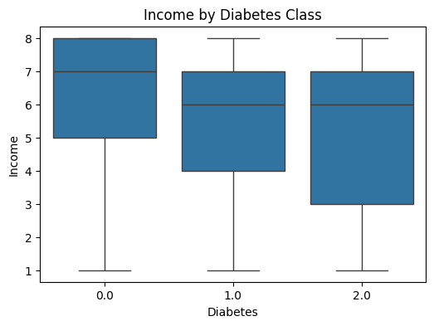
Preliminary Data Analysis
Notes:
Jenna

Slide 7
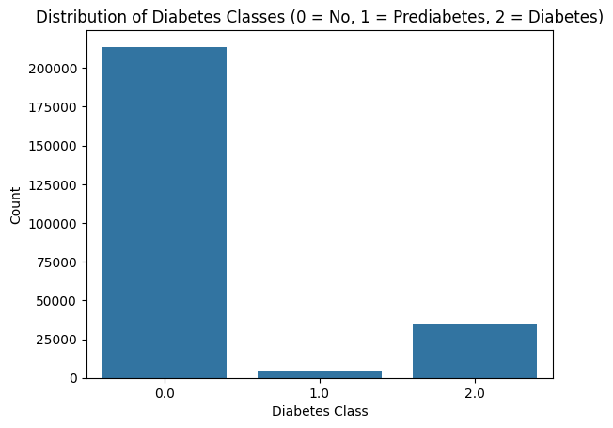
Balancing Class Distribution
Class distribution of target variable is very unbalanced
Healthy (0): 213,703
Prediabetic (1): 4,631
Diabetic (2): 35,346
Resampled to balance target distribution
Resampled minority classes (1, 2) with replacement to have same sample size as majority
All classes → n = 213,703
Notes:
Jenna

Slide 8
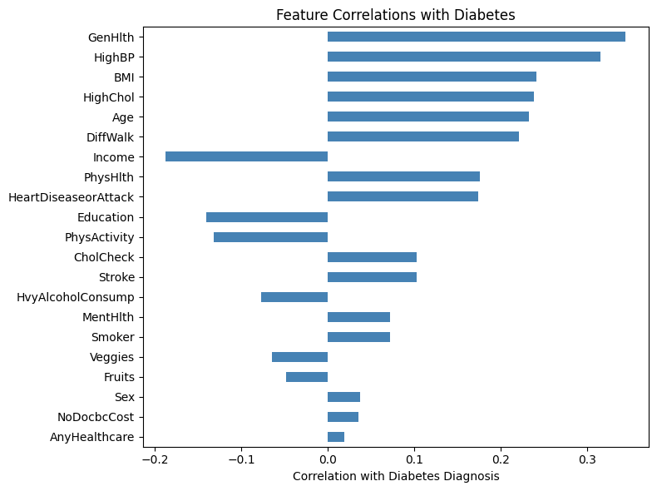
Feature Correlations
Positive correlations
As these factors increase, we expect risk of diabetes to increase
Blood pressure
BMI
Cholesterol level / Strokes
Age
Poor mental / physical health
Negative correlations
As these factors decrease, we expect risk of diabetes to increase
Income level
Education
Physical Activity level
Notes:
Jenna

Slide 9
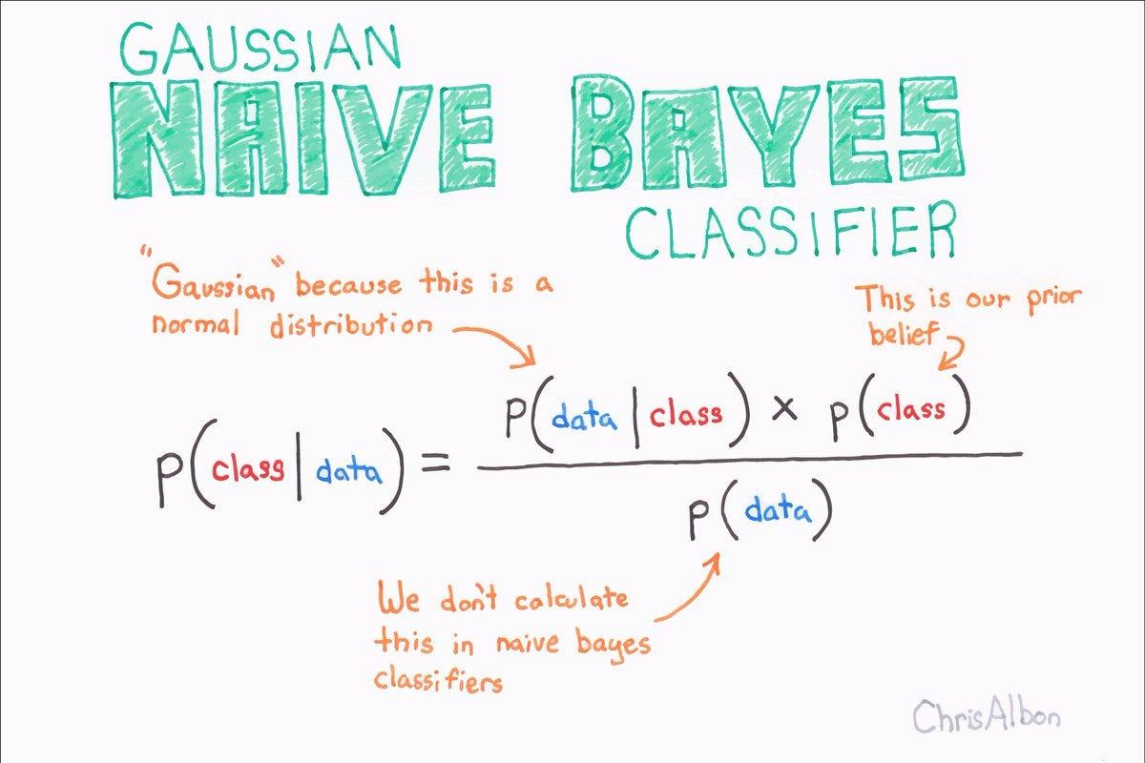
Naive Bayes Classifier
Assumptions:
Each class follows a normal distribution
Features are independent from each other
We also normalized the data beforehand to keep scaling consistent
Based on Bayes’ Theorem:
When classifying a new sample:
Start with the prior probability
Update probability with likelihood function (normal distribution)
Assign class to sample with the highest posterior probability
Notes:
Nidhi

Slide 10
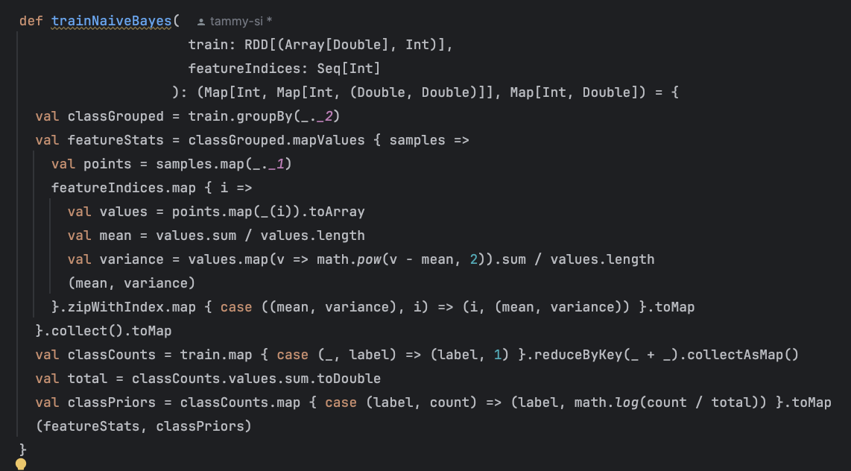
Notes:
Nidhi

Slide 11
1. Group data by class label ( healthy / prediabetic / diabetic)
2. For each feature vector:
Compute mean, variance
Corresponds to modeling
P(x | y = c) ~ N(μ_{ic}, σ_{ic}^2)
3. Compute class prior probabilities (taking the log)
4. Return (featureStats, classPriors) to calculate posterior probability later on
Notes:
Nidhi

Slide 12
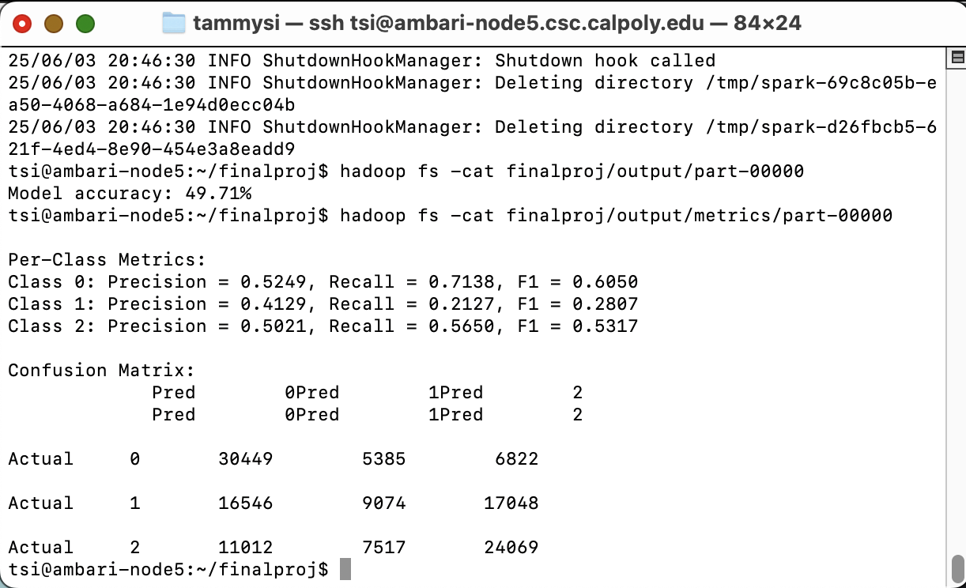

Proof we’re not frauds and the code can distributedly compute

Slide 13
Results
 | Metrics
Group | Precision | Recall | F1
Healthy | 0.5290 | 0.7138 | 0.6050
Prediabetic | 0.4129 | 0.2127 | 0.2807
Diabetic | 0.5021 | 0.5650 | 0.5317
After testing our model on different feature subsets, overall accuracy was still around 0.49.
Notes:
Nidhi

Slide 14


 | Metrics
Group | Precision | Recall | F1
Healthy | 0.5290 | 0.7138 | 0.6050
Prediabetic | 0.4129 | 0.2127 | 0.2807
Diabetic | 0.5021 | 0.5650 | 0.5317
Classifier performs best when predicting healthy individuals
Highest F1 = 0.60
Precision is lower → more false positives
Expected because our original dataset has mostly healthy individuals
Classifier performs poorly on predicting prediabetic status
Lowest F1 = 0.28
Least represented class before resampling
Prediabetics may share similar characteristics with borderline healthy / diabetic patients
Notes:
Nidhi

Slide 15
Issues / Key Takeaways
Obstacles
Key takeaways
Naive Bayes not suited for this data
Small sample size
Normal distribution assumption
Independence assumption between features
Class imbalance
Healthy individuals overrepresented → hard to classify diabetics + prediabetics
Overall trends in demographics/socioeconomic status did not differ drastically across patients and thus features of this nature may exhibit low predictive power
Conditions such as high cholesterol and high blood pressure may be risk factors for diabetes
Notes:
Jenna

Slide 16
Thanks!
Questions?

